Slide 1


SQL CITY MURDER MYSTERY CASE STUDY
By: Abdul Raffay Naeem

Slide 2


CASE
A crime has taken place and the detective needs your help. The detective gave you the crime scene report, but you somehow lost it. You vaguely remember that the crime was a ​murder​ that occurred sometime on ​Jan.15, 2018​ and that it took place in ​SQL City​. Start by retrieving the corresponding crime scene report from the police department’s database.

Slide 3
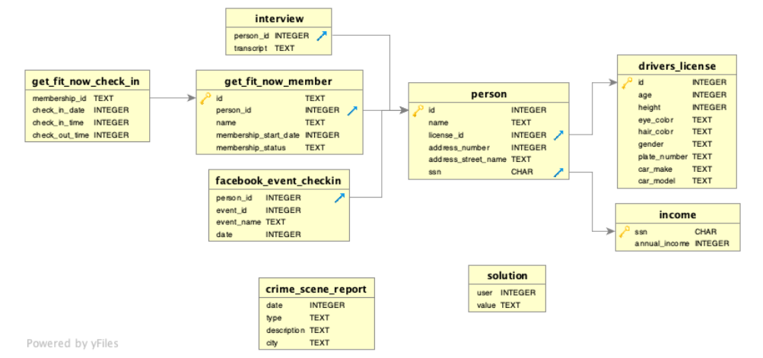
DATABASE SCHEMA

Slide 4
01
Identifying Incident
From the crime_scene_report table, the data of the murder incident which occurred on 15th Jan, 2018 in SQL City was retrieved.

Slide 5
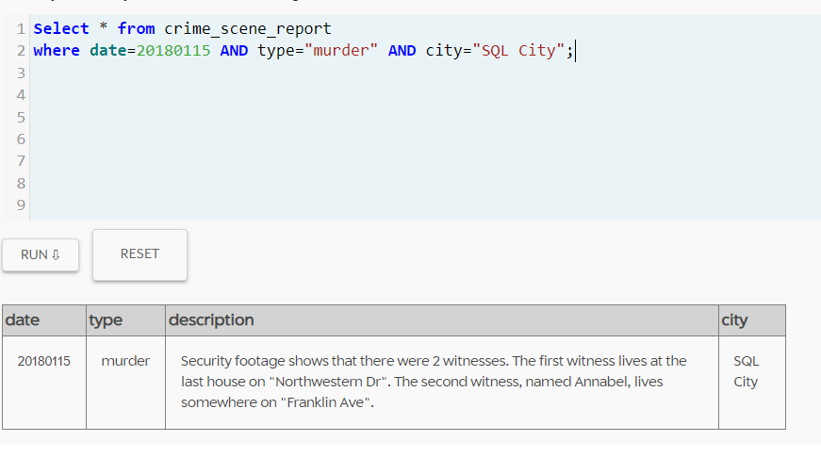

Slide 6
02
Transcripts of Witnesses
Using the information retrieved in the previous query, the interview transcripts of the witnesses were investigated from the interview table.

Slide 7
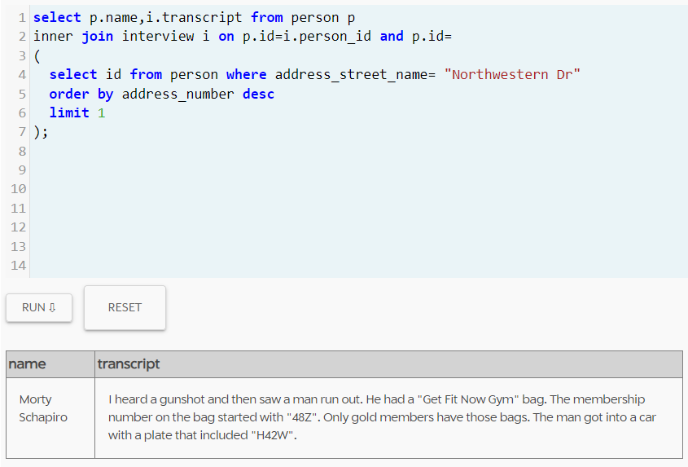

Slide 8
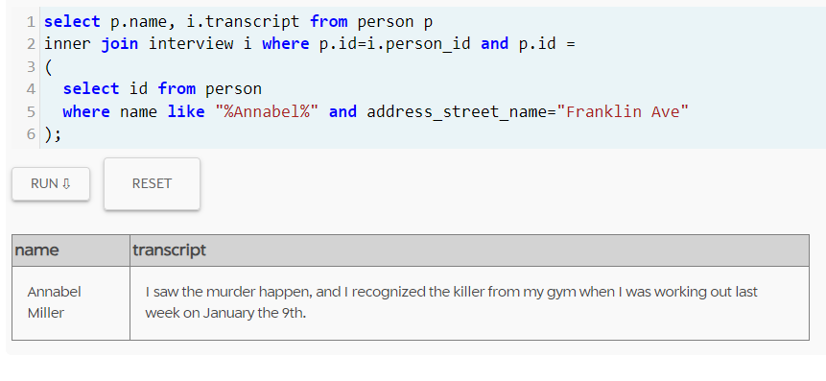

Slide 9
03
Identifying the Shooter
Using the details obtained from Morty Schapiro’s and Annabel’s interview, the person was identified from the person table and then verified from the get_fit_now_check_in table.

Slide 10
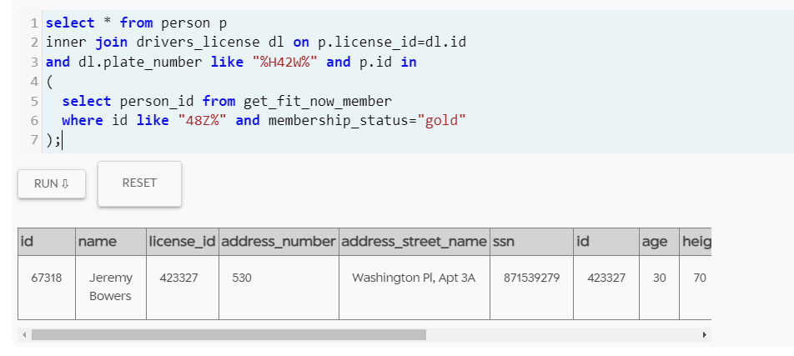

Slide 11
04
Shooter’s Interview
Using the information obtained in the last query, the interview of the shooter was analyzed using the interview table.

Slide 12
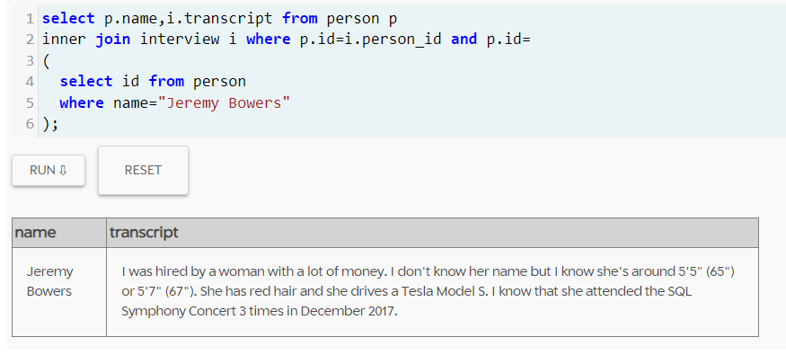

Slide 13
05
Identifying the Mastermind
Using all the details obtained from the shooters interview, the brains of the murder incident was uncovered.

Slide 14
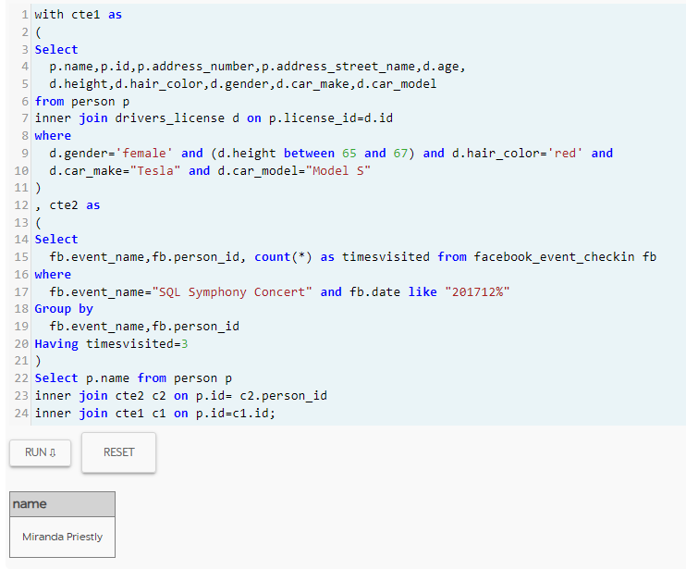

Slide 15

THE MASTERMIND WAS MIRANDA PRIESTLY

Slide 16
THANK YOU

